Slide 1
Ubiquitous Computing
Niloy Ganguly

Slide 2
Introduction
What do we mean by ubiquitous computing?
  computing that is omnipresent and is, or appears to be, everywhere all the time; may involve many different computing devices that are embedded in various devices or appliances and operate in the background.
  Ubiquitous Computing can be thought of as the idea of invisible computers everywhere. Specifically, it is the idea that computers are embedded in the environment, with literally dozens or hundreds of computers available to each person, and each computer performing its tasks without requiring human awareness or a large amount of human intervention.

Slide 3
evolution
Mainframe represents the era of "many people, one computer“.
PC is the era of "one person, one computer“.
ubiquitous computing can be thought of as the era of "one person, many computers".

Slide 4
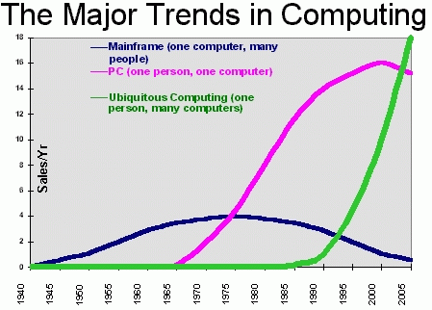
Research trend

Slide 5
Ubiquitous Computing
Architecture
Peer to Peer
Smart Places
Sensors and Actuators (Sensor Networks)
Ad-Hoc Networks (MANET)
Delay Tolerant Networks.
Cloud Computing
Theory/Algorithm
Growth of Network – grows incrementally
Connectivity and speed of information dissemination
Mobility
Localization
Pricing

Slide 6
Tentative topics that we will cover
Peer to Peer networks (12 Hours)
  Introduction to peer-to-peer networks, advantage over client server, structured and unstructured, examples (1 hr)
  Structured p2p network, DHT, routing and search principles, Chord, Pastry etc (2hrs)
  Unstructured p2p, search algorithms, flooding, random walk, Gnutella, comparative discussion between structured and unstructured(2 hrs)

Slide 7
  Superpeer networks, working principle, routing methodology, workload of superpeers, design challenges, (1 hr)
  P2p bootstrapping, various peer servents, their working principles and comparative study (1hr).
  Designing p2p crawlers, measurement study on various topological issues and content distribution, Bandwidth utilization. (1hr)

Slide 8
  Security issues in p2p networks, attacks like DoS, Sybil, Eclipse (1hr), defence strategies
  Trust and reputation in p2p (1hr)
  Recent issues: Multimedia dissemination over p2p networks, Mobile p2p etc (1hr)
  Case study Skype, Bittorrent Network (1hr)

Slide 9
Human–computer interaction (1 Hour)
Ubiquitous Environment (1 Hour)
Mobility Model (2 Hours)
Context awareness and localization (3 Hours).
Sensor Networks (2 Hours)
Mobile ad-hoc network ( 4 Hours)
  Delay tolerant network.
  Different routing.
Privacy (2 Hours)
  Problems of Authentication
  Confidentiality

Slide 10
Distributed Computing (1 Hour)
Cloud Computing (2 Hour)
Applications (1 Hour)
  Health and Medical Computing
  Social Computing
  Surveillance

